Slide 1
Welcome to
6th Grade Reading/Writing Workshop

Slide 2
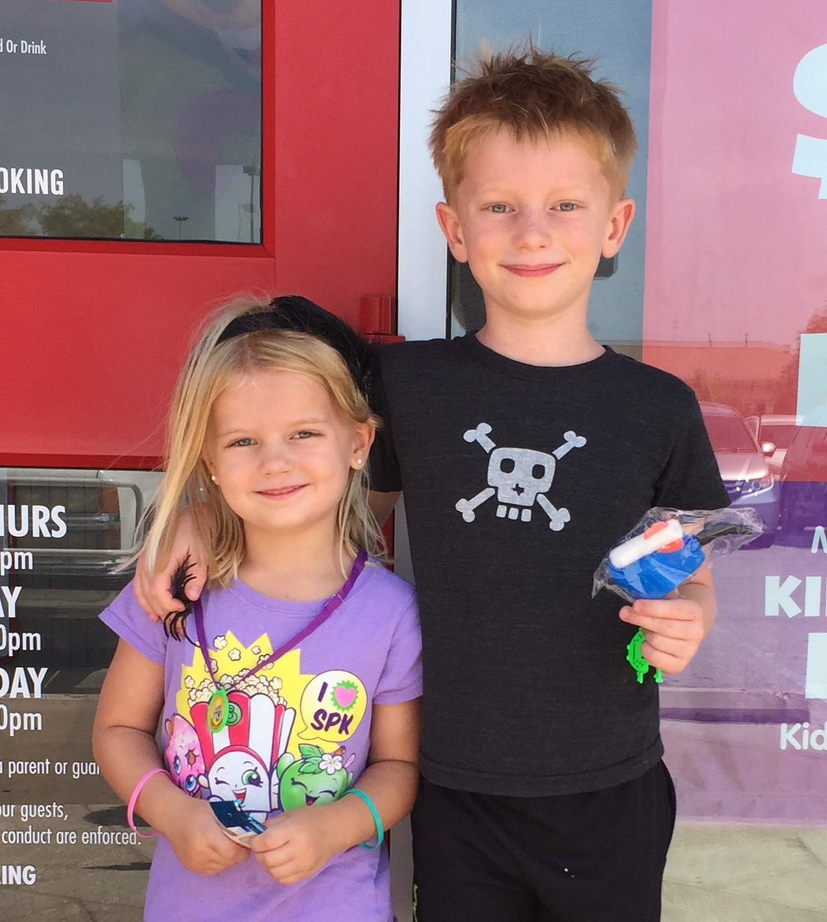
About Mrs. Loontjer
Fifteen years of teaching
experience
Ten years at Canyon Vista
Four years in 8th grade LA
Six years in 6th LA
Five years teaching private reading and writing classes in 1st-9th grade
Graduate of the University of Texas at Austin
Originally from San Antonio, Texas

Slide 3
A QUICK OVERVIEW
OF OUR CLASS
High interest novels read together
Lots of discussion
Writing in response to reading
Goals:
deeper thinking about what they read
strong “fix-up” strategies when they get stuck
an increased love of reading

Slide 4
Books We’re Planning to Read

Slide 5
Reading Expectations and Accountability - Outside Book
*Students need to read their current book for 30 minutes daily (same homework as LA - they do not need to double).
*Students should bring their current book to class EVERY DAY. (The book travels to and from school.)
*Students are held accountable using “Status.”

Slide 6
Status
*Status is a system for the teacher to track the students’ reading.
*We take status nearly every day during the first ten minutes of class. (Current book title, page, total number of pages)
*Grades are given on status based on individual reading goals set by the student and teacher.

Slide 7
Typical Class Agenda
10 minutes - Status/reading current book/individual reading conferences
5-10 minutes - responding to my individual notes in thought log/individual writing conferences
20 minutes - reading class novel together and discussing as we go (fix-up strategies, deeper meaning, writerly decisions)
10-15 minutes - Practicing a target reading skill (sometimes together, sometimes individually)

Slide 8
Grading
Daily Grades - 25% - on average, ten per six weeks
In class assignments based on daily lessons
Thought log responses to current book and class book
Quiz Grades - 40% - on average, four per six weeks
Short writing pieces
In class reading quizzes
Test Grades - 35% - on average, two per six weeks
Longer written responses to literature
Projects

Slide 9
Visit Mrs. Loontjer’s Website
http://loontjer.weebly.com/

Slide 10
Questions?

