Slide 1
Welcome to
6th Grade Language Arts!

Slide 2
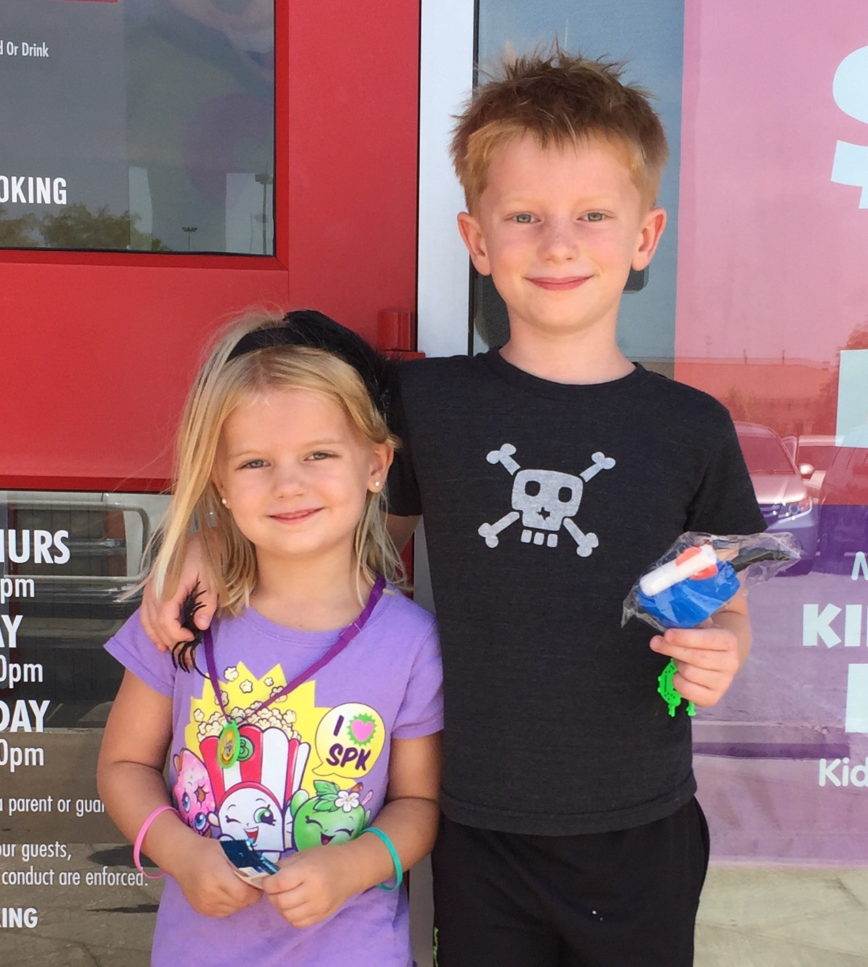
About Mrs. Loontjer
Fifteen years of teaching
experience
Ten years at Canyon Vista
Four years in 8th grade LA
Six years in 6th LA
Five years teaching private reading and writing classes for 1st-9th grade students
Graduate of the University of Texas at Austin
Originally from San Antonio, Texas

Slide 3
Grading
Daily Grades - 25% - on average, ten per six weeks
In class assignments based on daily lessons
Occasional homework assignments
Quiz Grades - 40% - on average, four per six weeks
Cumulative writing pieces (single draft)
In class quizzes
Test Grades - 35% - on average, two per six weeks
Published, multidraft writing pieces
Unit tests

Slide 4
Reading Expectations and Accountability
*Students need to read their current book for 30 minutes daily.
*Students should bring their current book to class EVERY DAY. (The book travels to and from school.)
*Students are expected to record books finished (as well as next books) on the book log in their writers’ notebooks.
*Students are held accountable using “Status.”

Slide 5
Status
*Status is a system to track the students’
reading.
*I take status nearly every day during the first five to ten minutes of class. (Current book title, page, total number of pages)
*As I take status, I conference with students individually about their reading.
*Grades are given on status based on individual reading goals set by the student and teacher.

Slide 6
What about writing?
*Students are expected to write regularly in the writer’s notebook. These entries are usually started in class and
might be finished outside of class. Their notebooks should come back and forth between home and school, just like their current reading book.
*In the writer’s notebook, students will explore different writing techniques and genres in order to strengthen their writing skills. By doing so, they will grow as independent thinkers and writers. Many of their published writing pieces will originate from these notebook entries.
* “A writer’s notebook give you a place to live like a writer, not just in school during writing time, but wherever you are, at any time of day.”
-Ralph Fletcher

Slide 7
Writing Workshop
*Each six weeks, we will publish at least one piece of writing.
Some will be based in the curriculum
Some will be choice pieces coming out of the writer’s notebook.
*We will take these writing pieces through the writing process (collecting in the writer’s notebook, planning, drafting, revising, editing, publishing).
*Individualized instruction takes place through writing conferences.

Slide 8
A QUICK OVERVIEW
OF OUR YEAR
Reading Genres: - Literary Nonfiction
- Literary Fiction - Poetry - Persuasion - Expository
- Multigenre
Writing Genres:
-Literary Nonfiction
-Reading Response -Poetry -Persuasive/Expository
Essay -Multigenre Project

Slide 9
Visit Mrs. Loontjer’s Website
http://loontjer.weebly.com/

Slide 10
Questions?

